Slide 1
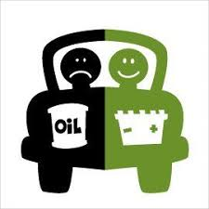
Unit 1:- Electric and Hybrid Powertrain Technologies
By:- Prof. Dr. Saket Yeolekar

Slide 2
Lecture 8
Pneumatic Hybrid Vehicles (PHVs)
Energy flow in supercharged mode in PHVs
Pressurized air Uses in PHVs
Series PHVs
Parallel PHVs
Challenges in PHVs
Vehicle Dynamics: Description of Vehicle Movement
Vehicle Dynamics: Vehicle Resistance
Rolling Resistance
Aerodynamic Drag: Shape drag
Aerodynamic Drag: Skin Friction
Grading Resistance
Dynamic Equation
Tire–Ground Adhesion and Maximum Tractive Effort

Slide 3
Pneumatic Hybrid Vehicles (PHVs)….
Pneumatic hybrid vehicles are based on the same principles as hybrid electric vehicles. They employ two energy sources, fuel and pressurized air, to propel the vehicle.
During braking, the kinetic energy of an air hybrid vehicle is converted to pressurized air by running the same ICE in the compressor mode.
Pneumatic hybrid engines can have four modes of operation:
    Compression Braking (CB)
    Air Motor (AM)
    Supercharged
    Conventional internal combustion
When the driver applies the brake pedal, fuel is shut off, and the engine operates as a two-stroke air compressor, storing the vehicle’s kinetic energy in the form of pressurized air in the reservoir tank

Slide 4
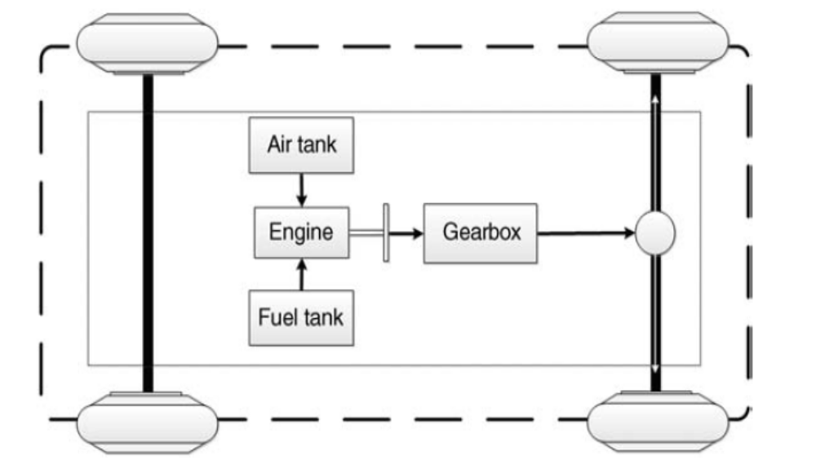
Energy flow in supercharged mode in PHVs….

Slide 5
Pressurized air Uses in PHVs….
There are various uses for the energy stored in the tank.
Run the internal combustion engine as an air motor. The charging valve between the air tank and engine opens and the pressurized air runs the engine as a two-stroke air motor. This mode operates during low load engine conditions to avoid high fuel consumption.
The second option of using the stored braking energy is to run the engine in air motor mode to start it up. It is possible to activate start-up mode after a long stop to avoid a cold start, or after a short stop to avoid engine idling, resulting in a lower engine fuel consumption and emission.
Stored energy can run the engine accessories. Some attempt has been made to remove all or some of the engine accessories from the engine to avoid excessive power losses.

Slide 6
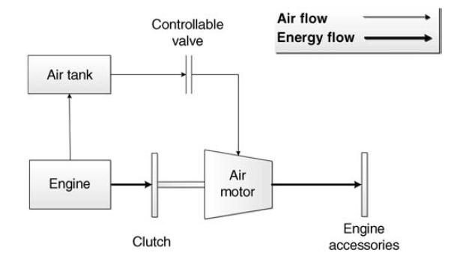
Series PHVs….
Series configuration for running engine accessories in PHVs

Slide 7
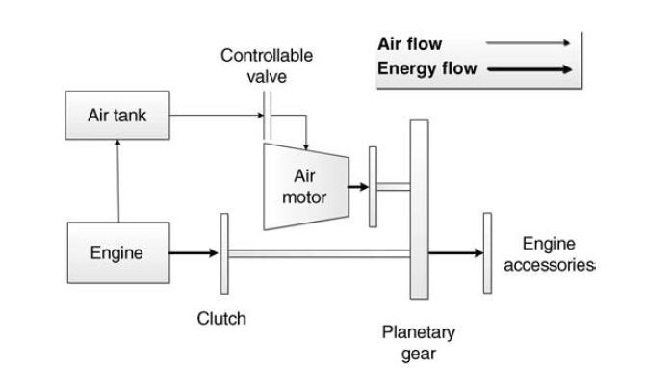
Parallel PHVs….
A parallel configuration for running engine accessories in PHVs

Slide 8
Challenges in PHVs….
Although the air hybrid concept seems to be simple, there are some practical issues to resolve before accepting the concept as a hybrid powertrain solution. One of the most important challenges of air hybrid engines is the poor energy-storing capacity of the system due to the low air pressure when the engine is used as a compressor.
The maximum storing pressure is a function of the engine compression ratio that limits the energy density of the stored pressurized air.
Another challenge in the implementation of air hybrid engines is the inevitability of using flexible valvetrains. Due to different operational modes, it requires a flexible valvetrain to implement the concept. This could increase the engine complexity and costs.

Slide 9
Challenges in PHVs….
Although the air hybrid concept seems to be simple, there are some practical issues to resolve before accepting the concept as a hybrid powertrain solution. One of the most important challenges of air hybrid engines is the poor energy-storing capacity of the system due to the low air pressure when the engine is used as a compressor.
The maximum storing pressure is a function of the engine compression ratio that limits the energy density of the stored pressurized air.
Another challenge in the implementation of air hybrid engines is the inevitability of using flexible valvetrains. Due to different operational modes, it requires a flexible valvetrain to implement the concept. This could increase the engine complexity and costs.

Slide 10

Vehicle Dynamics: Description of Vehicle Movement ….
The tractive effort, Ft, in the contact area between tires of the driven wheels and the road surface propels the vehicle forward. It is produced by the power plant torque and is transferred through transmission and final drive to the drive wheels.
While the vehicle is moving, there is resistance that tries to stop its movement. The resistance usually includes tire rolling resistance, aerodynamic drag, and uphill resistance.
According to Newton’s second law, vehicle acceleration can be written as
where V is vehicle speed, ΣFt is the total tractive effort of the vehicle, ΣFtr is the total resistance, Mv is the total mass of the vehicle, and δ is the mass factor, which is an effect of rotating components in the power train.

Slide 11
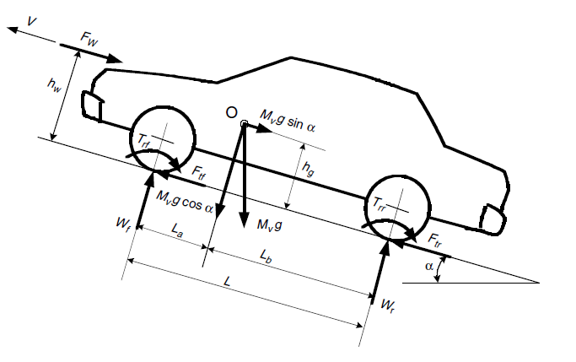
Vehicle Dynamics: Description of Vehicle Movement ….
Forces acting on a vehicle

Slide 12
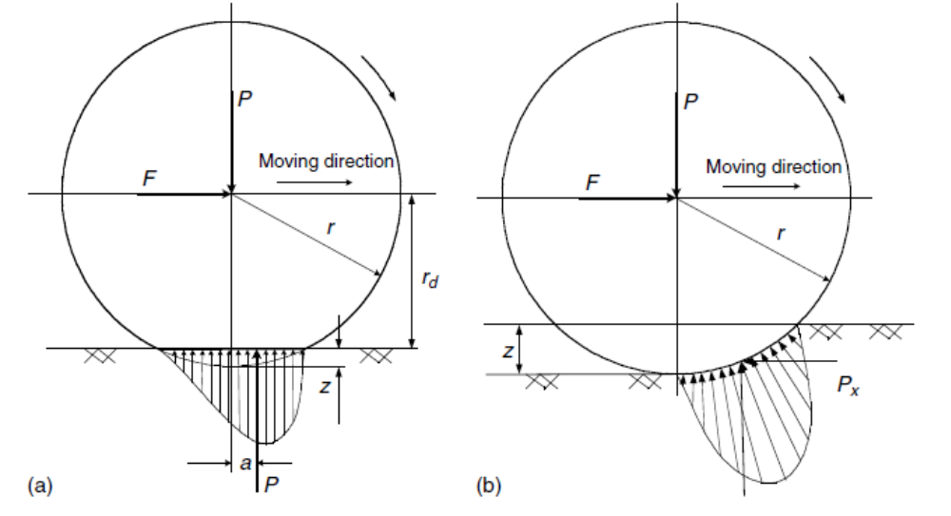
Vehicle Dynamics: Vehicle Resistance….
vehicle resistance opposing its movement includes:
  Rolling resistance of the tires (torque Trf and Trr)
  Aerodynamic drag, Fw
  Grading resistance, Mv g sin α
Tire deflection and rolling resistance on a (a) hard and (b) soft road surface
Forces acting on a vehicle

Slide 13
Rolling resistance ….
  Rolling resistance of the tires (torque Trf and Trr):
The rolling resistance of tires on hard surfaces is primarily caused by hysteresis in the tire materials.This is due to the deflection of the carcass while the tire is rolling.
The hysteresis causes an asymmetric distribution of ground reaction forces. The pressure in the leading half of the contact area is larger than that in the trailing half
On soft surfaces, the rolling resistance is primarily caused by deformation of the ground surface ground reaction force almost completely shifts to the leading half.
The rolling resistance coefficient, fr, is a function of the tire material, tire structure, tire temperature, tire inflation pressure, tread geometry, road roughness, road material, and the presence or absence of liquids on the road.

Slide 14
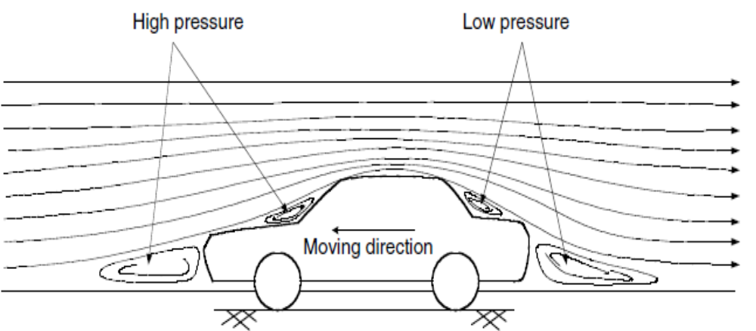
Aerodynamic Drag: Shape drag….
Avehicle traveling at a particular speed in air encounters a force resisting its motion. This force is referred to as aerodynamic drag. It mainly results from two components: Shape drag and Skin friction.
Shape drag: The forward motion of the vehicle pushes the air in front of it. However, the air cannot instantaneously move out of the way and its pressure is thus increased, resulting in high air pressure.
In addition, the air behind the vehicle cannot instantaneously fill the space left by the forward motion of the vehicle. This creates a zone of low air pressure.

Slide 15
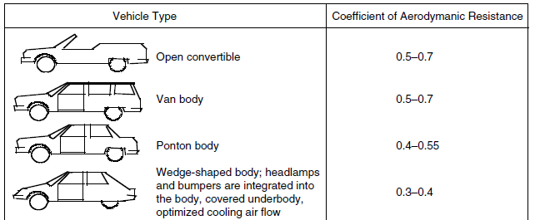
Aerodynamic Drag : Skin friction :….
Skin friction : Air close to the skin of the vehicle moves almost at the speed of the vehicle while air far from the vehicle remains still. In between, air molecules move at a wide range of speeds. The difference in speed between two air molecules produces a friction that results in the second component of aerodynamic drag.
Aerodynamic drag is a function of vehicle speed V, vehicle frontal area Af, shape of the vehicle, and air density ρ.
Indicative drag coefficients for different body shapes

Slide 16
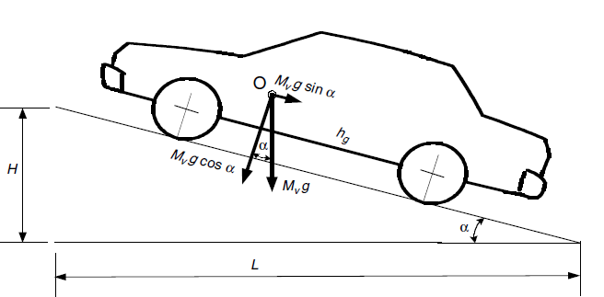
Grading Resistance ….
When a vehicle goes up or down a slope, its weight produces a component, which is always directed to the downward direction.
This component either opposes the forward motion (grade climbing) orhelps the forward motion (grade descending). In vehicle performance analysis, only uphill operation is considered. This grading force is usually called grading resistance. The road angle, α, is usually replaced by grade value when the road angle is small.
Fg=Mv* g* sinα.

Slide 17

Dynamic Equation….
In the longitudinal direction, the major external forces acting on a two-axle vehicle include the rolling resistance of front and rear tires Frf and Frr, which are represented by rolling resistance moment Trf
and Trr, aerodynamic drag Fw, grading resistance Fg (Mv g sinα), and tractive effort of the front and rear tires, Ftf and Ftr. Ftf is zero for a rear-wheel-driven vehicle, whereas Ftr is zero for a front-wheel-driven vehicle.
The dynamic equation of vehicle motion along the longitudinal direction is expressed by

Slide 18
Tire–Ground Adhesion and Maximum Tractive Effort….
When the tractive effort of a vehicle exceeds the due to the adhesive capability between the tire and the ground, the drive wheels will spin on the ground.
Actually, the adhesive capability between the tire and the ground is sometimes the main limitation of vehicle performance.
This is especially true when the vehicle drives on wet, icy, snow-covered, or soft soil roads. In this case, a tractive torque on the drive wheel would cause the slipping on the ground.
The maximum tractive effort on the driven wheel depends on the longitudinal force that the adhesive capability between the tire and ground can supply, rather than the maximum torque that the engine can supply.
Experiments shows that, the maximum tractive effort of the drive wheel closely relates to the slipping of the running wheel.

